Slide 1
West Coast Waste Assessment 2024
[Month] 2024 updates

Slide 2
Objectives
This workshop will:
Familiarise Elected Members with Councils statutory waste planning requirements
Provide an understanding of the district's current waste performance
Present some ideas for the future
Discuss the potential ways for how we can get there

Slide 3
Strategic context
Central Government Policy
Te rautaki para | Waste strategy
Waste Minimisation Act
Litter Act
Rautaki Hanganga o Aotearoa | Infrastructure Strategy
Emissions Reduction Plan
Local Government Act
Local Government Policy
West Coast Waste Assessment
West Coast Waste Management and Minimisation Plan
West Coast Long Term Plan
West Coast Annual Plan

Slide 4
What is a Waste Assessment?
3. How will we get there?
Options
Suitability/Assessment
Statement of proposals
Consultation with Medical Officer of Health
2. Where do we want to be?
Vision for the future
Policies/strategies
Goals
Objectives
Targets
1. Where are we now?
Material flows
Waste composition
Waste infrastructure/services
Diversion, recovery and reuse
Future demand

Slide 5
XX
[date to be added]
[date to be added]
[date to be added]
Council Workshop (today)
Draft Waste Assessment
to be reviewed by Medical Officer of Health
Council Meeting
Approval of final Waste Assessment and progress to WMMP
WMMP - key stakeholder engagement
[date to be added]
[date to be added]
[date to be added]
[date to be added]
Council Meeting
Approval of final WMMP
Draft WMMP updated
Draft WMMP public consultation
(in accordance with SCP in the LGA)
Council Workshop
Draft WMMP presented to Council for consultation

Slide 6
Waste Disposal Levy – expansion and increase
Landfill class | 2009 to June 2021 | 1 July 2021 | 1 July 2022 | 1 July 2023 | 1 July 2024
Municipal landfill (class 1) | $10 / tonne | $20 / tonne | $30 / tonne | $50 / tonne | $60 / tonne
Construction & demolition fill (class 2) |  |  | $20 / tonne | $20 / tonne | $30 / tonne
Managed or controlled fill (class 3 & 4) |  |  |  | $10 / tonne | $10 / tonne
West Coast Waste Disposal Levy Allocation
2018 - $XXX
2024/25 – approximately $XXX
Note: Cleanfills, Industrial Monofills and Transfer Stations are not levied but are subject to reporting requirements.

Slide 7
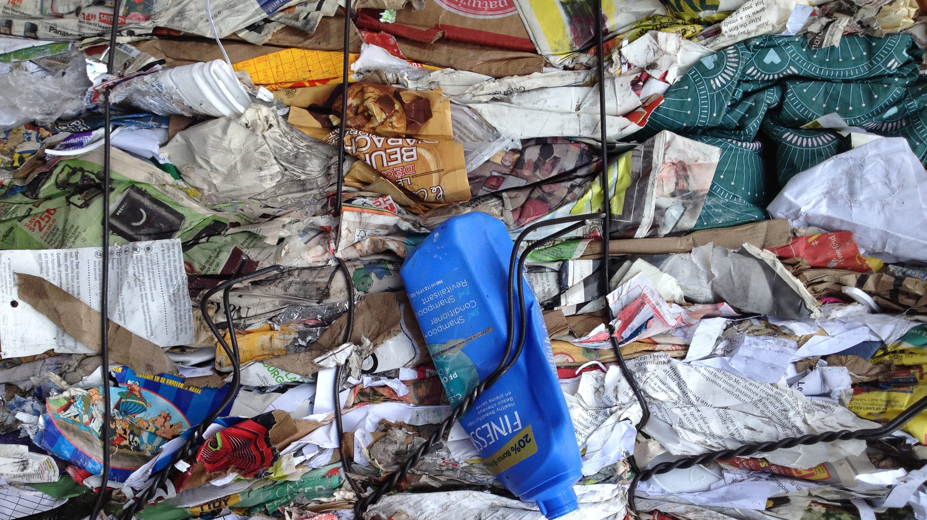
Where are we now?

Slide 8
What have we found out so far?
Total materials generated: XXkg per person.
Waste generation per capita in the West Coast has increased by XX% between 2018 and 2023.
Over the course of the previous WMMP waste diverted from landfill at Councils transfer stations has increased from XX% to XX%.

Slide 9
What have we found out so far? Progress against the previous WMMP
Initiative | Comment on progress

Slide 10
What have we found out so far? Progress against Te Rautaki Para
Reduce the amount of material entering the waste management system, by XX per cent per person
Waste Disposal: Reduce the amount of material that needs final disposal, by XX per cent per person.

Slide 11
Pause for Comments / Questions

Slide 12
Where do we want to be?

Slide 13
Vision
Supporting statement
Goal #1
Goal #2
Goal #3
Objective
Objective
Objective
Objective
Objective

Slide 14
How will we get there?

Slide 15
Focus Areas
What the data is telling us
Regional context and activities

Slide 16
Focus Areas
What the data is telling us
More levy funding is available for waste minimisation initiatives
We need to better understand our waste generation
Regional context and activities
What is our role in managing emerging waste streams from industry across our district (e.g. forestry)?
What opportunities are created by the future introduction of product stewardship schemes?
We need to reduce material generated and increase our diversion
How will we respond to MfE kerbside standardisation requirements?

Slide 17
What’s already underway?
Services
XX
XX
Infrastructure
XX
XX
Education
XX
Connections
XX
Policy
XX
Iwi aspirations
XX

Slide 18
Pause for Questions and Discussions

Slide 19
Where to from here?

Slide 20
[Date to be added]
[Date to be added]
[Date to be added]
[Date to be added]
Council Workshop (today)
Draft Waste Assessment
to be reviewed by Medical Officer of Health
Council Meeting
Approval of final Waste Assessment and progress to WMMP
WMMP - key stakeholder engagement
[Date to be added]
[Date to be added]
[Date to be added]
[Date to be added]
Council Meeting
Approval of final WMMP
Draft WMMP updated
Draft WMMP public consultation
Council Workshop
Draft WMMP presented to Council for consultation

